Slide 1
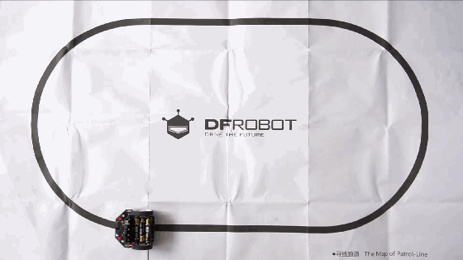
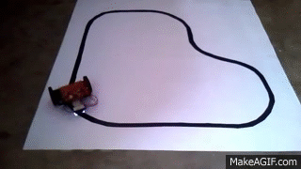

Presented by- Harsh Pallav & Rajat Sharma
Line Follower Robotics Workshop
Create a simple autonomous Line Following Robot.
An introduction to the exciting world of Autonomous Robotics.
DAY 1

Slide 2
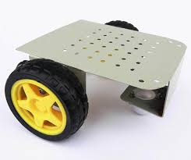
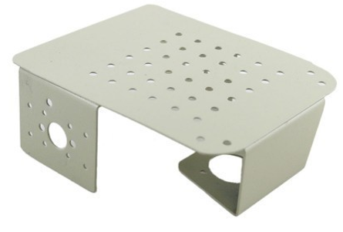
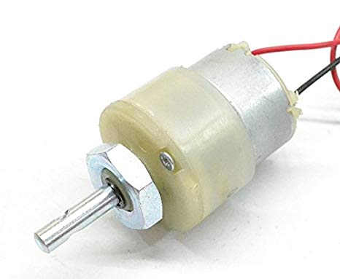
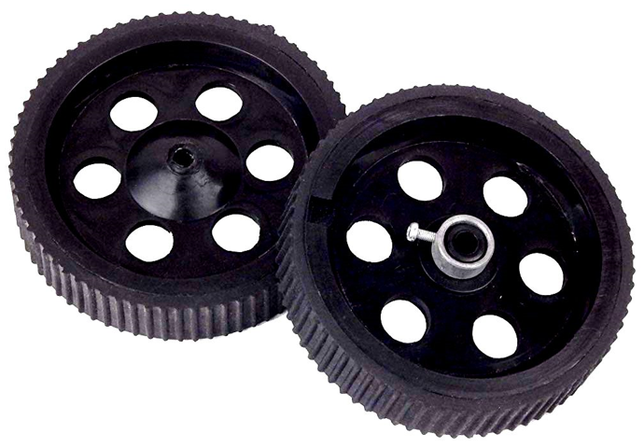
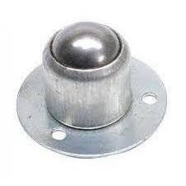


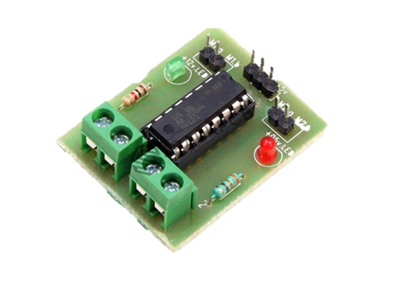
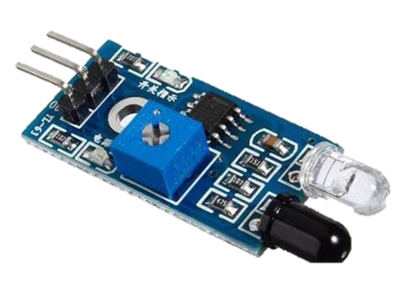

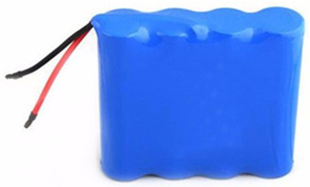
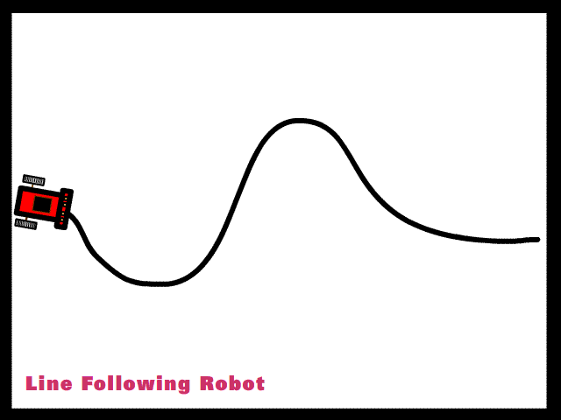
Workshop Flow-
DAY 1- Concept of LFR & Assembly of Robot
Step 1- Chassis
Step 2- DC Motors
Step 3- Wheels
Step 4- Castor Wheel
DAY 2- Programming & Testing of Robot
Step 5- Programming
Step 6- L293D Motor Driver
Step 7- IR Module
Step 8- Power Supply

Slide 3


Slide 4
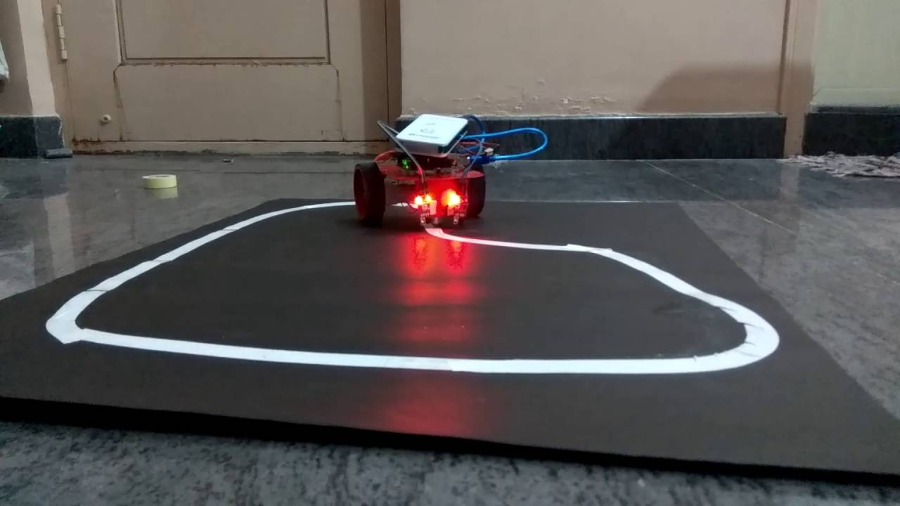
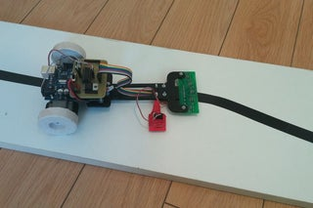
Introduction-
Line follower Robot is a machine which follows a line, either a black line or white line. Basically there are two types of line follower robots: one is black line follower which follows black line and second is white line follower which follows white line. Line follower actually senses the line and run over it.
White Line Follower
Black Line Follower

Slide 5
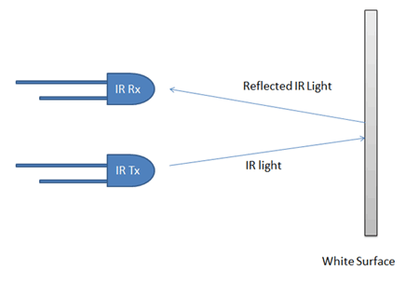
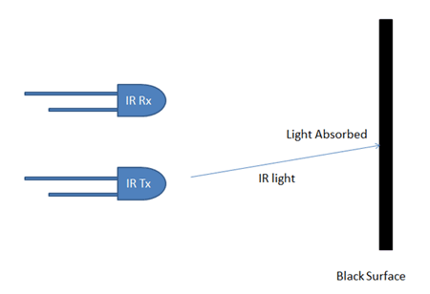
Concept of Line Follower-
Concept of line follower is related to light. We have used the behavior of light at black and white surface. When light fall on a white surface it will almost full reflects and in case of black surface light is absorbed by black surface. This explained behavior of light is used in this line follower robot.

Slide 6
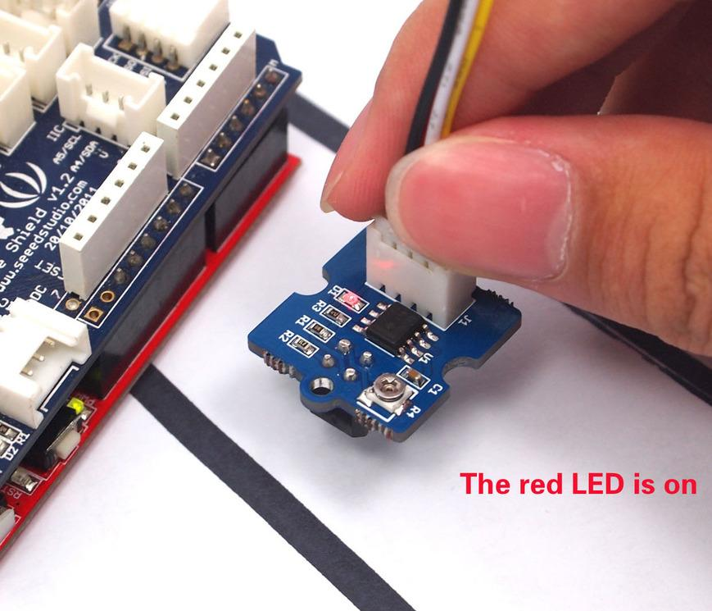
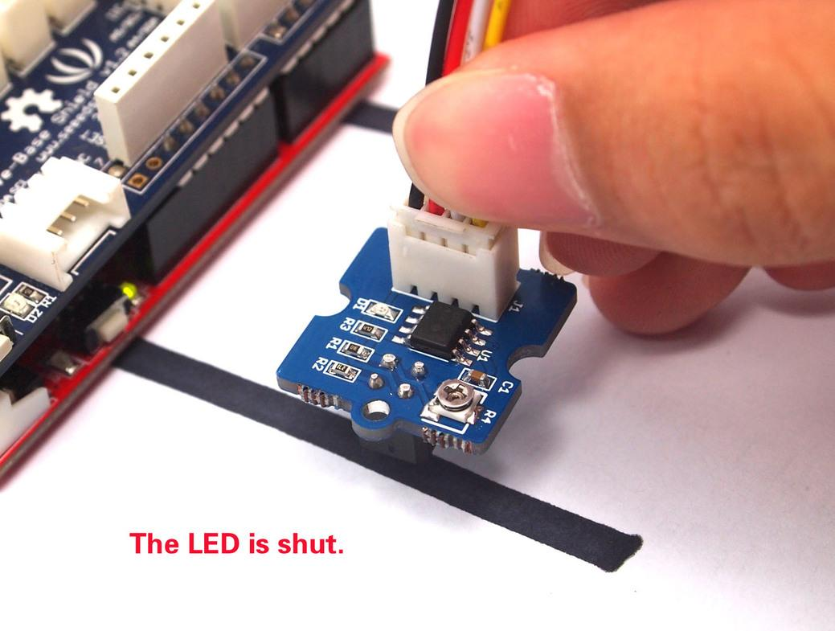
In this line follower robot project we have used IR Transmitters and IR receivers also called photo diodes for sending and receiving light.
IR transmits infrared lights. When infrared rays falls on white surface, it is reflected back and catched by photodiode and generates some voltage changes.
When IR light falls on black surface light is absorbed by the black surface and not rays reflect back, so photo diode did not received any light or rays.
Here in this line follower robot when sensor senses white surface then microcontroller gets 1 as input and when senses black line microcontroller gets 0 as input.
IR gives 1 (HIGH) on WHITE surface as input
IR gives 0 (LOW) on BLACK surface as input

Slide 7
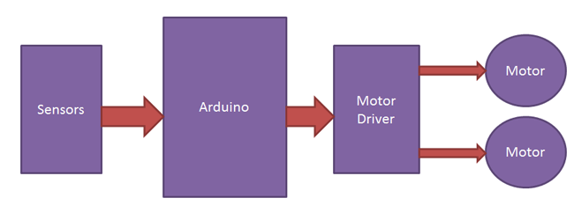
Working of Line Follower-
Line follower robot senses black line by using sensor and then sends signals to Arduino. Then Arduino drives the motor according to sensors' output.
INPUT
PROCESSING
OUTPUT

Slide 8
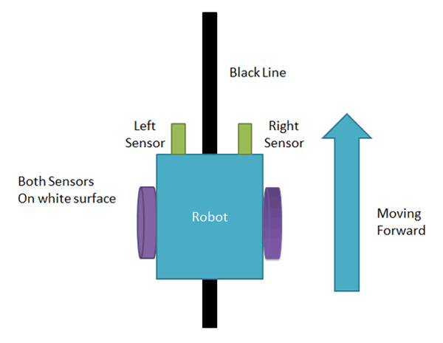
Case 1- Moving Forward
When both left and right sensor senses white then robot move forward.

Slide 9
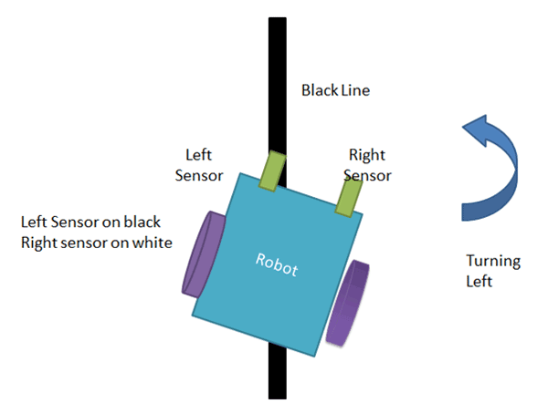
Case 2- Turning Left
If left sensor comes on black line then robot turn left side.

Slide 10
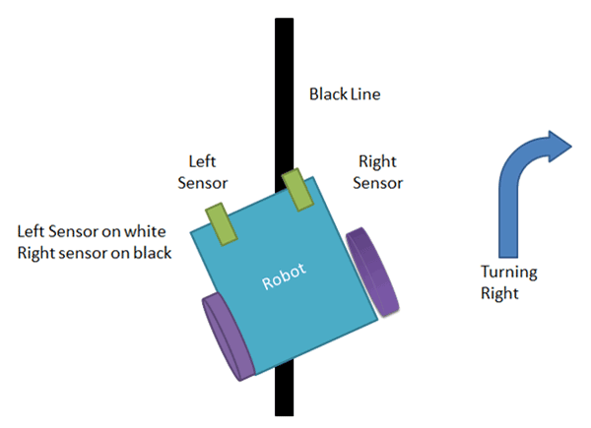
Case 3- Turning Right
If right sensor sense black line then robot turn right side until both sensor comes at white surface. When white surface comes robot starts moving on forward again.

Slide 11
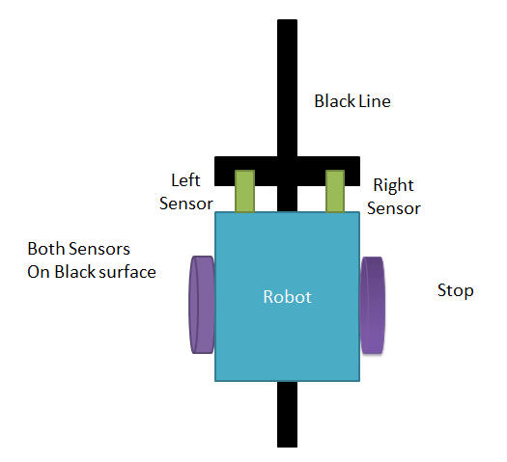
Case 4-Stop
If both sensors comes on black line, robot stops.

Slide 12


Slide 13
Step 1- Take out Chassis

Slide 14
Step 2- Solder Wires to DC Motor

Slide 15
Step 3- Attach DC Motor with Chassis

Slide 16
Step 4- Attach wheels with DC Motor

Slide 17
Step 5- Attach Castor Wheel with Chassis

Slide 18

Great! You have assembled the Robot

Slide 19

END OF DAY 1

